Slide 1

Deep Neural Network
AIML Module 9
Seetha Parameswaran
BITS Pilani

Slide 2
The author of this deck, Prof. Seetha Parameswaran, is gratefully acknowledging the authors who made their course materials freely available online.

Slide 3
Time Series Modelling and Forecasting

Slide 4
What we Learn….
9.1 Univariate, Multivariate and Multi-step CNN Models
9.2 Univariate, Multivariate and Multi-step LSTM Models
Notes:
Talk about each topic in 1 or 2 sentences.

Slide 5
Time Series Data

Slide 6
Time series Data
General definition: “A time series is a collection of observations made
sequentially through time, whose dynamics is often characterized by short/long period fluctuations (seasonality and cycles) and/or long period direction (trend)”.
Such observations may be denoted by X_1 , X_2 , X_3 , ... X_t , ... , X_T since data are usually collected at discrete points in time.
The interval between observations can be any time interval (seconds, minute, hours, days, weeks, months, quarters, years, etc.) and we assume that these time periods are equally spaced.
One of the most distinctive characteristics of a time series is the mutual dependence between the observations, generally called SERIAL CORRELATION OR AUTOCORRELATION.

Slide 7
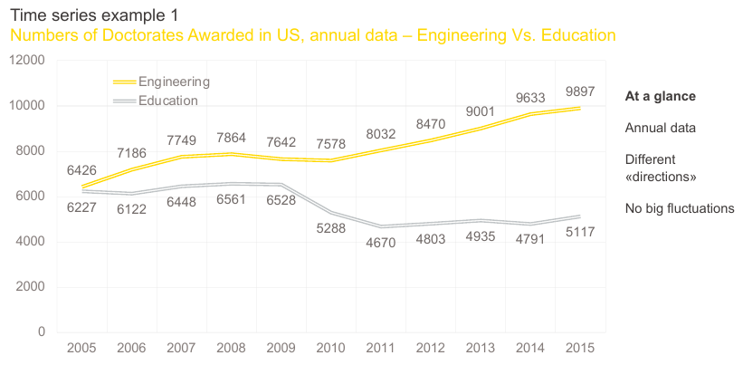

Slide 8
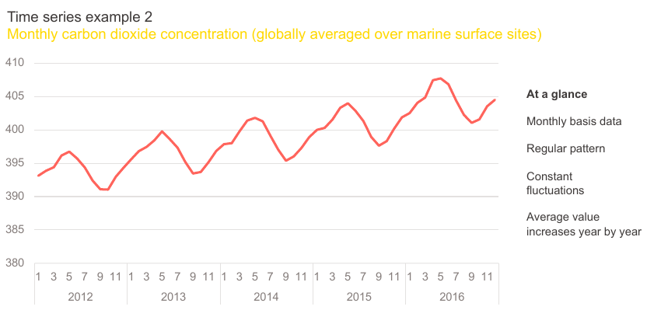

Slide 9
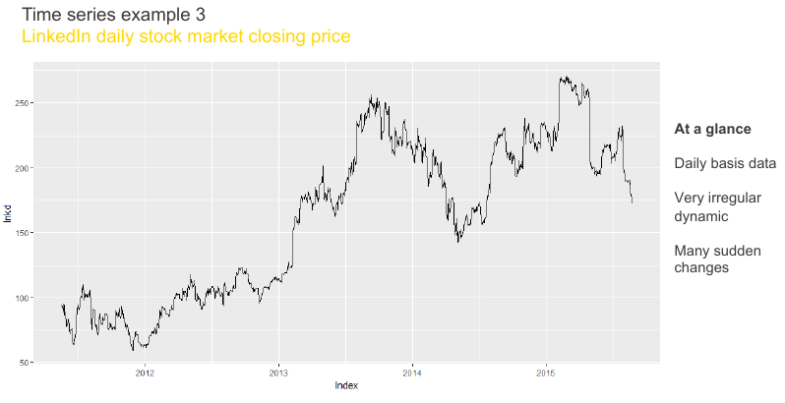

Slide 10
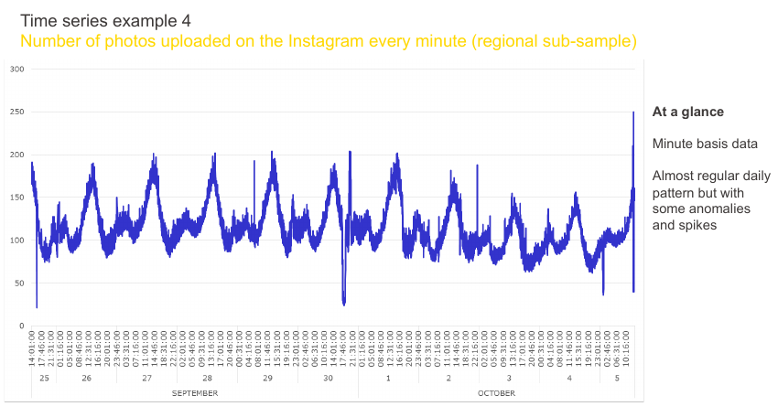

Slide 11
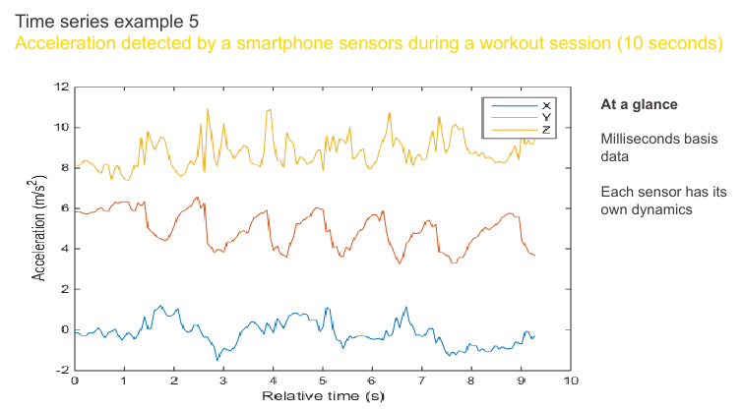

Slide 12
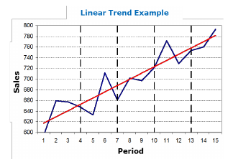
Time Series Data Properties: Main Elements
TREND
The general direction in which the series is running during a long period.
A TREND exists when there is a long-term increase or decrease in the data.
It does not have to be necessarily linear (could be exponential or others functional form).

Slide 13
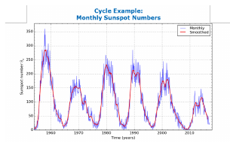
Time Series Data Properties: Main Elements
2. CYCLE
Long-term fluctuations that occur regularly in the series.
A CYCLE is an oscillatory component (i.e. Upward or Downward swings) which is repeated after a certain number of years, so:
May vary in length and usually lasts several years (from 2 up to 20/30)
Difficult to detect, because it is often confused with the trend component.

Slide 14
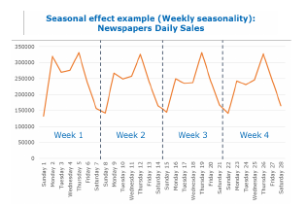
Time Series Data Properties: Main Elements
3. SEASONAL EFFECTS
Short-term fluctuations that occur regularly - often associated with months or quarters.
A SEASONAL PATTERN exists when a series is influenced by seasonal factors (e.g., the quarter of the year, the month, day of the week).
Seasonality is always of a fixed and known period.

Slide 15
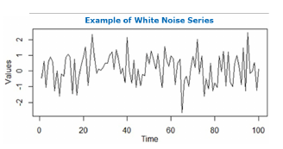
Time Series Data Properties: Main Elements
4. RESIDUAL
Whatever remains after the other components have been taken into account.
The residual/error component is everything that is not considered in previous components.
Typically, it is assumed to be the sum of a set of random factors (e.g. a white noise series) not relevant for describing the dynamics of the series.

Slide 16
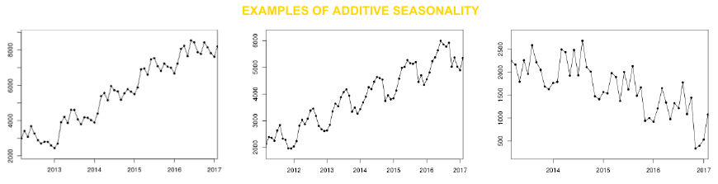
Seasonal effect: Additive Seasonality
When the seasonality in Additive, the dynamics of the components are independents from each other; for instance, an increase in the trend-cycle will not cause an increase in the magnitude of seasonal dips.
The difference of the trend and the raw data is roughly constant in similar periods of time (months, quarters) irrespectively of the tendency of the trend.

Slide 17
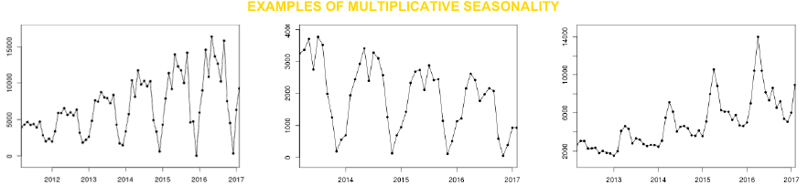
Seasonal effect: Multiplicative Seasonality
In the multiplicative model the amplitude of the seasonality increase (decrease) with an increasing (decreasing) trend, therefore, on the contrary to the additive case, the components are not independent from each other.
When the variation in the seasonal pattern (or the variation around the trend-cycle) appears to be proportional to the level of the time series, then a multiplicative model is more appropriate.

Slide 18
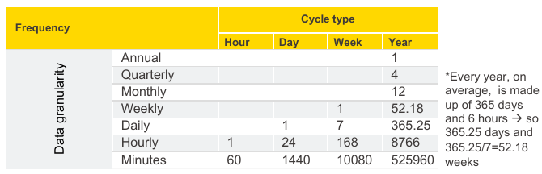
Seasonal effect: Frequency
According to the data granularity and to the type of seasonality you want to model, it is important to consider the right seasonal frequency (i.e. how many observations you have for every seasonal cycle)
For annual seasonality, the data points are years, quarters, months or weeks (in this case you will face only annual seasonality), but if the frequency of observations is smaller than a week, things get more complicated.

Slide 19
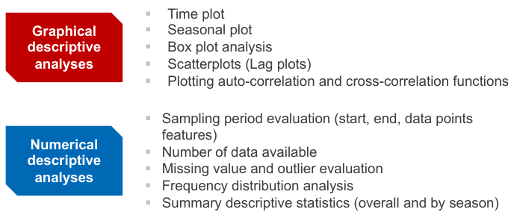
Numerical and Graphical description of Time Series
The first step in Time Series Analysis is to produce a detailed exploratory analysis of the data to get some insights about the distribution of the series over time.

Slide 20
Time Series Data and Analysis

Slide 21
Time Series Analysis
Time series analysis is a specific way of analyzing a sequence of data points collected over an interval of time.
Time is a crucial variable because it shows how the data adjusts over the course of the data points as well as the final results. It provides an additional source of information and a set order of dependencies between the data.
Time series analysis involves developing models to gain an understanding of the data to understand the underlying causes. Analysis can provide the “why” behind the outcomes you are seeing.
Forecasting then takes the next step of what to do with that knowledge and the predictable extrapolations of what might happen in the future.
Notes:
https://www.tableau.com/learn/articles/time-series-forecasting

Slide 22
Main Objectives of Time Series Analysis
Summary description (graphical and numerical) of data point vs. time
Interpretation of specific series features (e.g. seasonality, trend, relationship with other series)
Forecasting (e.g. predict the series values in (t + 1), (t + 2), ... , (t + k))
Hypothesis testing and Simulation (comparing different scenarios)

Slide 23
Time Series Forecasting

Slide 24
Time Series Forecasting
Time series forecasting is the process of analyzing time series data using statistics and modeling to make predictions and inform strategic decision-making.
Time series forecasting is part of predictive analytics.
It can show likely changes in the data, like seasonality or cyclic behavior, which provides a better understanding of data variables and helps forecast better.
Notes:
https://www.tableau.com/learn/articles/time-series-forecasting

Slide 25
Challenges in Time Series Forecasting
At the time of the work, the future outcome is completely unavailable and can only be estimated through careful analysis and evidence-based priors.
Likelihood of forecasts can vary wildly, especially when dealing with the commonly fluctuating variables in time series data as well as factors outside our control.
Notes:
https://www.tableau.com/learn/articles/time-series-forecasting

Slide 26
Applications of Time Series Forecasting
Weather forecasting
Climate forecasting
Economic forecasting
Healthcare forecasting
Engineering forecasting
Finance forecasting
Retail forecasting
Business forecasting
Environmental studies forecasting
Social studies forecasting
Notes:
Self study by students

Slide 27
Time series forecasting considerations
Time horizons
The time frame of your forecast is known as a time horizon.
Time horizon is a fixed point in time where the forecast ends.
It’s much easier to forecast a shorter time horizon with fewer variables than it is a longer time horizon.
Dynamic and static states
If the forecast is static, it is set in stone once it is made, so make sure your data is adequate for a forecast.
Dynamic forecasts can be constantly updated with new information as it comes in. This means you can have less data at the time the forecast is made, and then get more accurate predictions as data is added.
Notes:
https://www.tableau.com/learn/articles/time-series-forecasting

Slide 28
Time series forecasting considerations
Data quality
Typical guidelines for data quality apply.
Make sure data is complete,
Data is not duplicated or redundant,
Data was collected in a timely and consistent manner,
Data is in a standard and valid format,
Data is accurate for what it is measuring,
Data is uniform across sets.
Data is collected at consistent intervals over the period of time being tracked. This helps account for trends in the data, cyclic behavior, and seasonality. It also can help identify if an outlier is truly an outlier or if it is part of a larger cycle. Gaps in the data can hide cycles or seasonal variation, skewing the forecast as a result.
Notes:
https://www.tableau.com/learn/articles/time-series-forecasting

Slide 29
Limitations of Classical Methods for TS Forecasting
Focus on complete data: missing or corrupt data is generally unsupported.
Focus on linear relationships: assuming a linear relationship excludes more complex joint distributions.
Focus on fixed temporal dependence: the relationship between observations at different times, and the number of lag observations provided as input, must be diagnosed and specified.
Focus on univariate data: many real-world problems have multiple input variables.
Focus on one-step forecasts: many real-world problems require forecasts with a long time horizon.

Slide 30
Strengths of DNN for TS Forecasting
Robust to Noise. Neural networks are robust to noise in input data and in the mapping function and can support learning and prediction in the presence of missing values.
Nonlinear. Neural networks do not make strong assumptions about the mapping function and readily learn linear and nonlinear relationships.
Multivariate Inputs. An arbitrary number of input features can be specified, providing direct support for multivariate forecasting.
Multi-step Forecasts. An arbitrary number of output values can be specified, providing direct support for multi-step and even multivariate forecasting.

Slide 31
Strengths of DNN for TS Forecasting
Feature Learning in CNN. Automatic identification, extraction and distillation of salient features from raw input data that pertain directly to the prediction problem that is being modeled.
Native Support for Sequences. Recurrent neural networks directly add support for input sequence data.
Learned Temporal Dependence. The most relevant context of input observations to the expected output is learned and can change dynamically.

Slide 32
Limitations of DNN for TS Forecasting
The mapping function is fixed or static.
Fixed Inputs. The number of lag input variables is fixed, in the same way as traditional time series forecasting methods.
Fixed Outputs. The number of output variables is also fixed; although a more subtle issue, it means that for each input pattern, one output must be produced.

Slide 33
Framework for Time Series Forecasting

Slide 34
Framework
Time series forecasting involves developing and using a predictive model on data where there is an ordered relationship between observations.

Slide 35
Framework
What are the inputs and outputs for a forecast?
Inputs: Historical data provided to the model in order to make a single forecast.
Outputs: Prediction or forecast for a future time step beyond the data provided as input.
What are the endogenous and exogenous variables?
Endogenous: Input variables that are influenced by other variables in the system and on which the output variable depends.
Exogenous: Input variables that are not influenced by other variables in the system and on which the output variable depends.
Are you working on a regression or classification predictive modeling problem?
 Regression: Forecast a numerical quantity.
 Classification: Classify as one of two or more labels.

Slide 36
Framework
Are the time series variables unstructured or structured?
Unstructured: No obvious systematic time-dependent pattern in a time series variable.
Structured: Systematic time-dependent patterns in a time series variable (e.g. trend and/or seasonality).
Are you working on a univariate or multivariate time series problem?
Univariate: One variable measured over time.
Multivariate: Multiple variables measured over time.
Univariate and Multivariate Inputs: One or multiple input variables measured over time.
Univariate and Multivariate Outputs: One or multiple output variables to be predicted.

Slide 37
Framework
Do you require a single-step or a multi-step forecast?
One-step: Forecast the next time step.
Multi-step: Forecast more than one future time steps.
Do you require a static or a dynamically updated model?
Static. A forecast model is fit once and used to make predictions.
Dynamic. A forecast model is fit on newly available data prior to each prediction.
Are your observations contiguous or discontiguous?
 Contiguous. Observations are made uniform over time.
 Discontiguous. Observations are not uniform over time.

Slide 38
Steps to Develop a Forecasting Model
Define Problem.
Inputs vs. Outputs: What are the inputs and outputs for a forecast?
Endogenous vs. Exogenous: What are the endogenous and exogenous variables?
Unstructured vs. Structured: Are the time series variables unstructured or structured?
Regression vs. Classification: Are you working on a regression or classification predictive modeling problem? What are some alternate ways to frame your time series forecasting problem?
Univariate vs. Multivariate: Are you working on a univariate or multivariate time series problem?
Single-step vs. Multi-step: Do you require a single-step or a multi-step forecast?
Static vs. Dynamic: Do you require a static or a dynamically updated model?
Contiguous vs. Discontiguous: Are your observations contiguous or discontiguous?
Some useful tools to help get answers include:
 Data visualizations (e.g. line plots, etc.).
 Statistical analysis (e.g. ACF/PACF plots, etc.).

Slide 39
Steps to Develop a Forecasting Model
Design Test Harness
Split the dataset into a train and test set.
Fit a candidate approach on the training dataset.
Make predictions on the test set.
Calculate a metric that compares the predictions to the expected values.

Slide 40
Steps to Develop a Forecasting Model
Test Models.: Test many models using your test harness.
Baseline. Simple forecasting methods such as persistence and averages.
Autoregression. The Box-Jenkins process and methods such as SARIMA.
Exponential Smoothing. Single, double and triple exponential smoothing methods.
Linear Machine Learning. Linear regression methods and variants such as regularization.
Nonlinear Machine Learning. kNN, decision trees, support vector regression and more.
Ensemble Machine Learning. Random forest, gradient boosting, stacking and more.
Deep Learning. MLPs, CNNs, LSTMs, and Hybrid models.

Slide 41
Steps to Develop a Forecasting Model
Finalize Model.
List of the top 5 to 10 candidate models that are skillful on the problem.
Pick one or multiple models and finalize them. This involves training a new final model on all available historical data (train and test). The model is ready for use.

Slide 42
Prepare Time Series Data for DNNs

Slide 43
Prepare Time Series Data for DNNs
Objectives
Transform a time series dataset into a two-dimensional supervised learning format.
Transform a two-dimensional time series dataset into a three-dimensional structure suitable for CNNs and LSTMs.
Split a very long time series into subsequences ready for training a CNN or LSTM model.

Slide 44
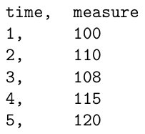
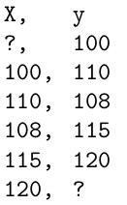
Time Series Data to 2D Supervised Learning Data
Univariate Time Series Data
Using sliding window method.
Univariate Time Series Data for supervised learning
Notes:
Convert using basic data structure manipulations

Slide 45
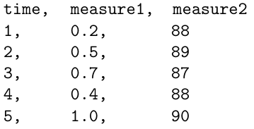
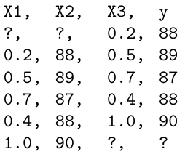
Time Series Data to 2D Supervised Learning Data
Multivariate Time Series Data
Using sliding window method.
Multivariate Time Series Data for supervised learning
Notes:
Convert using basic data structure manipulations

Slide 46
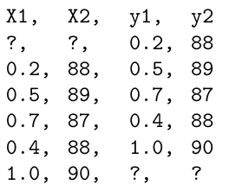
Time Series Data to 2D Supervised Learning Data
Multivariate Time Series Data
Using sliding window method.
Multivariate Time Series Data for sequence prediction (multi-step)
Notes:
Convert using basic data structure manipulations

Slide 47
Time Series Data to 3D Supervised Learning Data
First convert time series data to 2D data for supervised learning.
Then convert 2D data to 3D data.
The input layer for CNN and LSTM models is specified by the input shape argument on the first hidden layer of the network.
The input to every CNN and LSTM layer must be three-dimensional.
The three dimensions of this input are [samples, timesteps, features]
Samples. One sequence is one sample.
Time Steps. One time step is one point of observation in the sample. One sample is comprised of multiple time steps.
Features. One feature is one observation at a time step. One time step is comprised of one or more features.

Slide 48
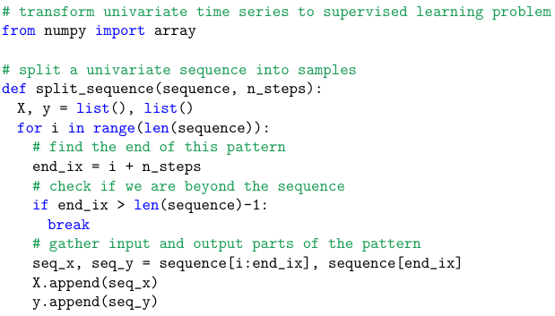

Example: Helper function

Slide 49
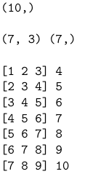
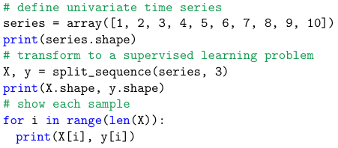
Example: Convert TS data to 2D data

Slide 50

Example

Slide 51
CNNs for Time Series Forecasting

Slide 52
Univariate CNN Models
Univariate time series are datasets comprised of a single series of observations with a temporal ordering and a model is required to learn from the series of past observations to predict the next value in the sequence.
The CNN model will learn a function that maps a sequence of past observations as input to an output observation.
A one-dimensional CNN is a CNN model that has a convolutional hidden layer that operates over a 1D sequence.

Slide 53
Demo Code for CNN
Univariate CNN
https://colab.research.google.com/drive/1VXCnwxtRdFkDYlxGqhnEuQeXTjQNc0uM#scrollTo=Ifms-u8BBraF
Multivariate CNN
https://colab.research.google.com/drive/1aADi0xKTExjZSReSFmwTke_Ws4yAwp4k#scrollTo=8kDtsv_uJygm
PS: Use BITS email ID to access files.

Slide 54
RNNs for Time Series Forecasting

Slide 55
Univariate RNN Models
The LSTM model will learn a function that maps a sequence of past observations as input to an output observation.
The sequence of observations must be transformed into multiple examples from which the LSTM can learn.

Slide 56
Demo Code for RNN
Univariate RNN
https://colab.research.google.com/drive/1b-ORe5WeYHpTHgcpFKPIoWRQcWNLXBq_#scrollTo=vfZ36VoM9ZIh
Multivariate RNN
https://colab.research.google.com/drive/1s5bsuW-wmxyuPkIK_C4mOwc8JPqlMwwS
PS: Use BITS email ID to access files.

Slide 57
Ref
Deep Learning for Time Series Forecasting by Jason Brownlee (R4)
https://www.tableau.com/learn/articles/time-series-forecasting

Slide 58
Next Session:
CNN

